Slide 1
Presenter: Haonan Wang
Decoupling Cores, Kernels, and Operating Systems
Gerd Zellweger, Simon Gerber, Kornilios Kourtis, Timothy Roscoe

Slide 2
Outline
Motivations
Implementation
Evaluation
Conclusion

Slide 3
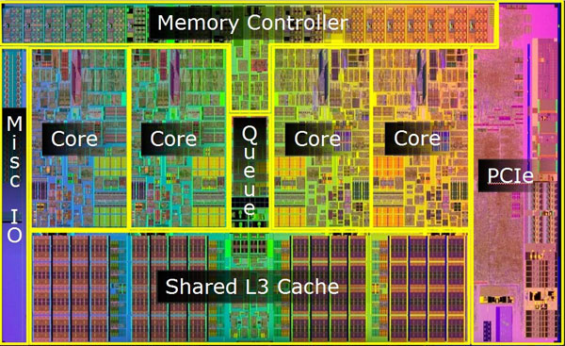
Problems with Multicores
Power consumption
Hard real-time applications
Hotplug
Notes:
▪ Fast and power hungry vs. slow and power efficient
The implications for a future OS are that it must manage
a dynamic set of physical cores, and be able to adjust
to changes in the number, configuration, and microarchitecture
of cores available at runtime, while maintaining a
stable execution environment for applications.

Slide 4
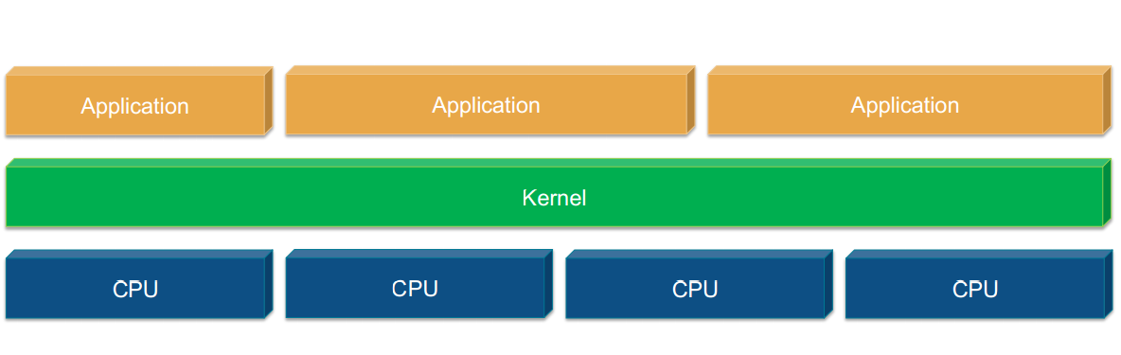
Current OSes
Notes:
Locks, per core states, sychronization

Slide 5
Approaches
Chameleon
Ksplice
Proteos
Otherworld

Slide 6
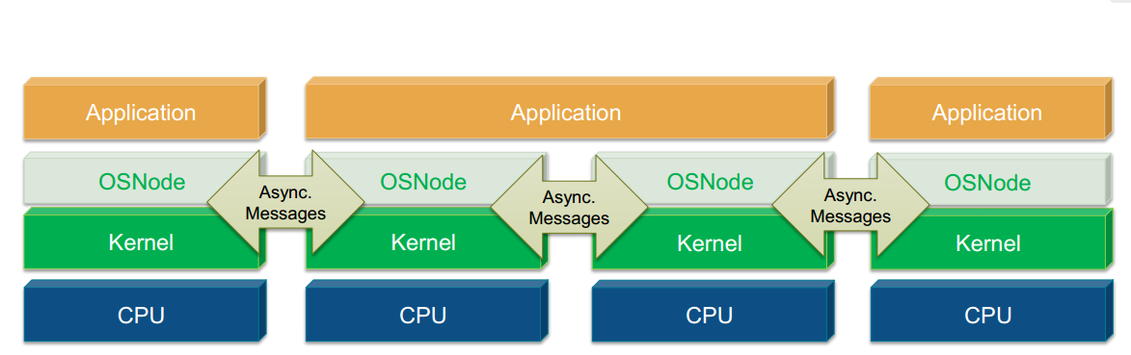
Multikernel OS
Notes:
fos [48], Akaros [40], Tessellation [33], Hive [14], and Barrelfish [8]

Slide 7
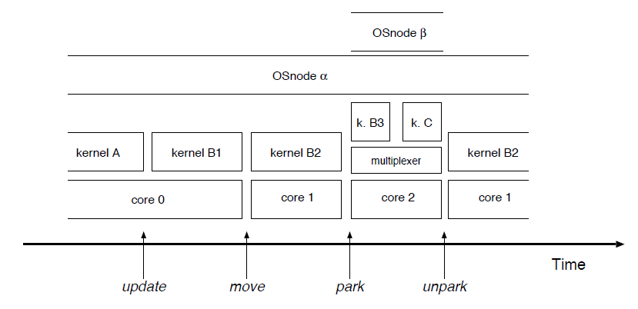
Basic Operations of a decoupled OS
Notes:
Update: The entire kernel, dispatching OSnode , is replaced
at runtime. Move: OSnode containing all per-core state, entailing applications is migrated to another core and kernel. Park:
OSnode is moved to a new core and kernel that temporarily dispatches two OSnodes. Unpark: OSnode is transferred back to
its previous core.

Slide 8
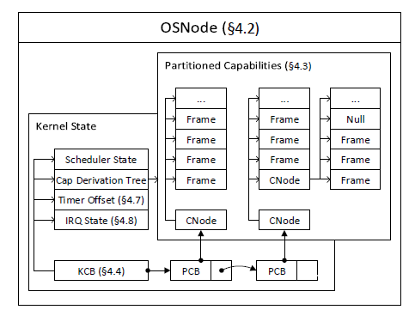
Per-core state
Notes:
Barrelfish OS

Slide 9
Capabilities

Slide 10
Kernel Control Blocks(KCB)
The minimal scheduling state
Interrupt state
Root of the capability derivation tree
The timer offset

Slide 11
Boot driver: booting a new core
Core detection and registration
Start boot driver
Boot kernel on the core
Start the new core
Integrate kernel into OS
Notes:
1. The new core is detected by some platform-specific mechanism (e.g., ACPI) and its appearance registered with the device management subsystem.
2. Barrelfish/DC selects and starts an appropriate boot driver for the new core.
3. Barrelfish/DC selects a kernel binary and arguments for the new core, and directs the boot driver to boot the kernel on the core.
4. The boot driver loads and relocates the kernel, and executes the hardware protocol to start the new core.
5. The new kernel initializes and uses existing Barrelfish protocols for integrating into the running OS.

Slide 12
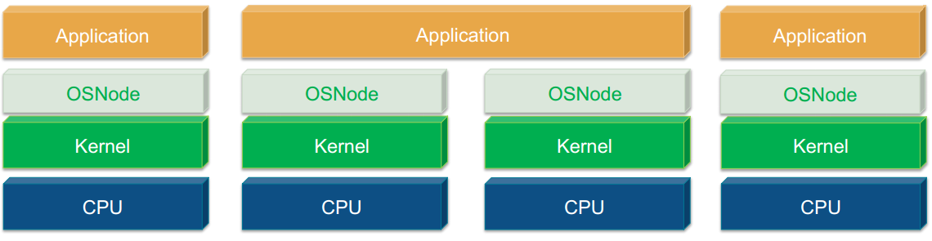
Shutting down a core

Slide 13
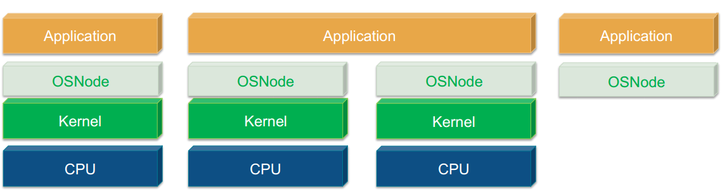
Shutting down a core

Slide 14
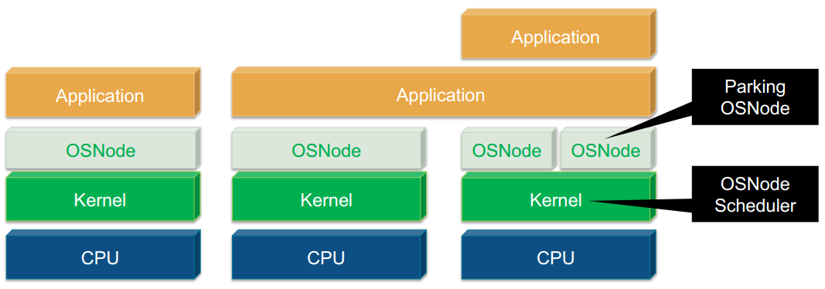
Shutting down a core

Slide 15
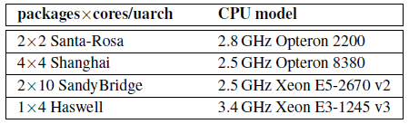
Systems used in evaluation

Slide 16
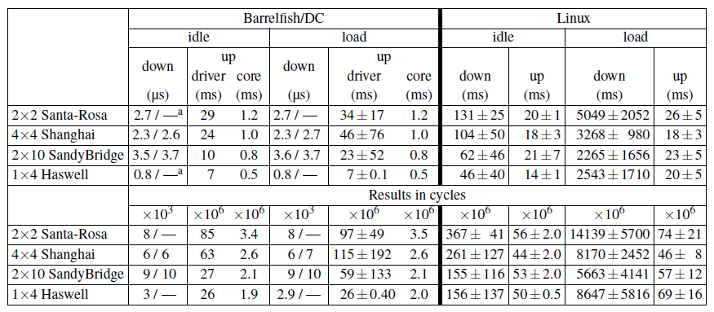
Core management operations

Slide 17
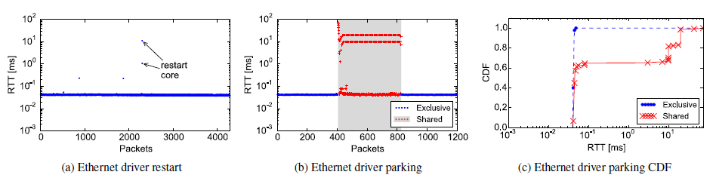
Applications

Slide 18
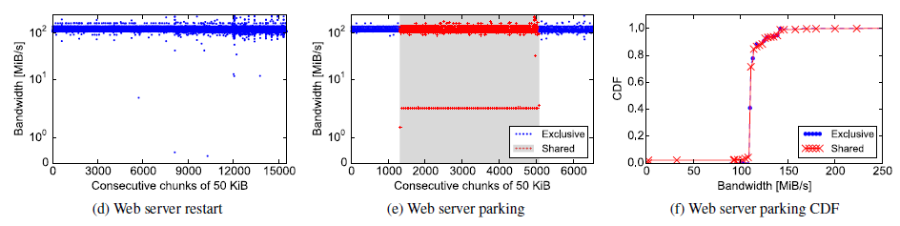
Applications

Slide 19
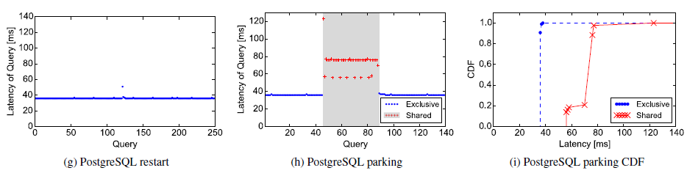
Applications

Slide 20
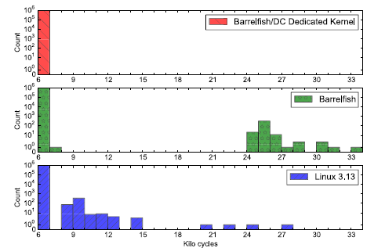
Performance isolation

Slide 21
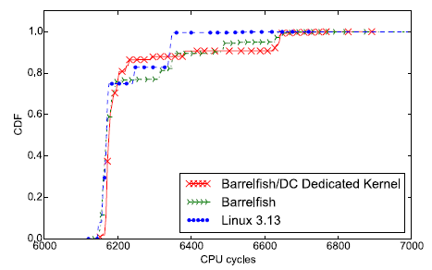
Performance isolation

Slide 22
Conclusion
In multicore architecures cores should be freely interchangeable.
Barrelfish/DC offers one approach to meeting this challenge.
Evaluation shows Barrelfish/DC is reliable.

Slide 23
Quiz questions
1. What are the basic operations of a decoupled OS?
2. What kind of kernel is needed for the parking operation?
3. Why there’s little overhead for Barrelfish/DC to shut down a core?

Slide 24
Thank You!

